Slide 1



Properties of Algol Eclipsing Binaries in the Large Magellanic Cloud
Qasim Mahmood
Faculty Advisor: Maxwell Moe, Ph.D.
University of Arizona
Department of Astronomy
April 22nd, 2017, ASU - Tempe
Notes:
Hello, my name is Qasim Mahmood and I’m going to be talking about the propertied of Algol eclipsing binaries in the LMC.

Slide 2
Algols
Oldest variable star documented (3,000 yrs.)
“Demon Star” in the constellation Perseus
Binary stars with inverted mass ratio after mass transfer
Progenitors for different supernova, short gamma ray bursts, and sources of gravitational waves
Notes:
What I want to say:
What are algols? Well algol specifically was one of the first variable stars to be see by the naked eye about 3000 years ago. Algol translates from Arabic to the Demon star in the constellation Perseus. The story goes that Persues defeated Medusa and her head is now his possession. The eye is the binary star that would flicker and looked like a wink. Many of the stars we see with our naked eye are often binary systems. Now, we describe Algols to be eclipsing binaries (nearly edge-on) with inverted mass ratios after undergoing mass transfer. They’re the ancestors of different types of supernova, such as type 1a.
http://www.dailymail.co.uk/sciencetech/article-3379438/The-flickering-demon-star-spotted-Egyptian-astronomers-3-000-years-ago.html
- Agol is the arabic word for demon’s head
- Flickering eye in Medusa’s head, now on Perseus’ belt.
- 93 light years away
http://space-facts.com/magellanic-clouds/
- LMC is 160,000 light years away, 30 billion stars, disrupted barred spiral type, highly active star formation region (Tarantula Nebula), gas-rich regions,
SMC is 200,000 light years away, 3 billion stars
More than 4/5 of stars we observe from the naked eye are two or more stars
http://www.space.com/22509-binary-stars.html
Langrangian point – where the gravitational forces are equal
Cooler and more massive giant donates to secondary main sequence primary, then have inverted mass ratios. The secondary becomes more massive. This is an algol
From the ones we have observes, over 50% have been Type 1a supernovae
http://www.sun.org/encyclopedia/supernova

Slide 3
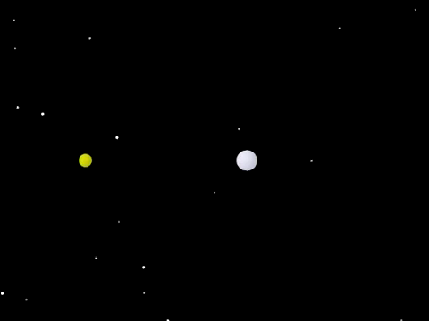
Notes:
Here’s an example of an algol. Once the roche lobe of the donor star fills, it starts to donate material to the gainer through the langragian point. That’s the point where the gravitational pull of both stars is equal. Over time, the gainer gets larger in mass and the donor becomes less massive. This is what an Algol is. The companion gainer starts from an A or B main sequence star and is now a giant.
http://astro.physics.uiowa.edu/~kaaret/s09/L12_starsmainseq.pdf
https://people.hofstra.edu/Brett_Bochner/PowerPoint_Lectures--AY12/AY12_Lec12--Stellar_Explosions--Low-High_Mass.pdf
The algols we are analyzing are semi-detached systems, primaries are A or B main sequence, companions are G or K giants/sub-giants filling their roche lobe.
The primary fills its roche-lobe while on its way to become a giant after leaving the main sequence stage
https://books.google.com/books?id=qt5sueHmtR4C&pg=PA352&lpg=PA352&dq=algol+system+semi+detached&source=bl&ots=HfbeWafl4E&sig=idSgskxvzMUFzov8ghovnPteJ6Y&hl=en&sa=X&ved=0ahUKEwjKg8yS9ojTAhXnzFQKHWSFBGcQ6AEIPDAI#v=onepage&q=algol%20system%20semi%20detached&f=false

Slide 4
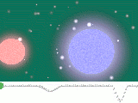
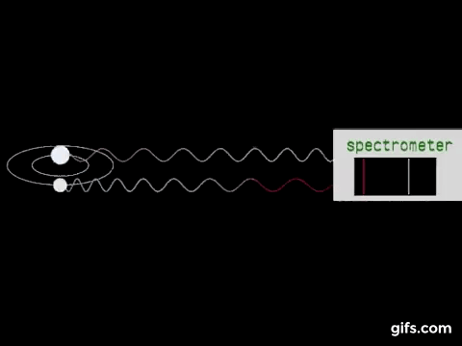
Photometry vs. Spectroscopy
Method | Technique | Pros | Cons
Photometry | Uses total light | Cheaper, farther reach | Less information
Spectroscopy | Spreads light out, uses intensity at each wavelength | More information | Expensive, shorter reach, more complex
Notes:
So the difference between photometric and spectroscopic is that photometry uses only light intensity while spectroscopy uses all of the light at all wavelengths. The problem is you can’t measure the properties of these algols based purely on photometric data. However, you can rely purely spectroscopic data. But we know spectroscopic measurements are more expensive, trickier, more complex. So, what our project is focusing on is finding a way to estimate the properties of these algols that only have photometric data by including some assumptions. What gave rise to this is because we sometimes only have the photometric data for systems.
http://www.differencebetween.com/difference-between-photometry-and-vs-spectrophotometry/
http://earthsky.org/brightest-stars/algol-the-demon-star , https://en.wikipedia.org/wiki/File:Eclipsing_binary_star_animation_2.gif

Slide 5
Methodology
50 Algols in our Milky Way Galaxy
400 Algols in the Large Magellanic Cloud
Nightfall light curve models based on parameters
11 parameters: Mass, temperature, albedos, inclination, dust extinction, and z-scores
Markov Chain Monte Carlo converges light curve models to photometric data
Notes:
So what we do know is we have spectroscopic data of algols in our galaxy. By using the spectroscopic measurements of algols in our galaxy, we calibrated the relationships between the mass of the gainer star and the radius and temperature (combining 3 parameters into 1). Then, we also know that the roche lobe of the donor is almost 1 with some very slight uncertainty which let us know the radius of the donor. On top, we know the distance of the LMC is ~200,000 ly. This allowed us to narrow down from 11 free parameters to just 6. Then, by using software that generates light curves using I input those interpolated values and used a Markov Chain Monte Carlo to step randomly and converge to a solution. The power in this way that we were able to find a unique solution with these assumptions because there’s no way to have unique solution with that many parameters.
So we stared off with about 50 well researched algols in our galaxy that do have good spectroscopic data and calibrated the relationships between parameters such as mass, radii, and temperature. Then we looked at systems in another galaxy that only have photometric data, I was able to interpolate their radii, and temperature. Then, by using software that generates light curves using I input those interpolated values and used a Markov Chain Monte Carlo to step randomly and converge to a best fit solution. The results were fantastic!

Slide 6
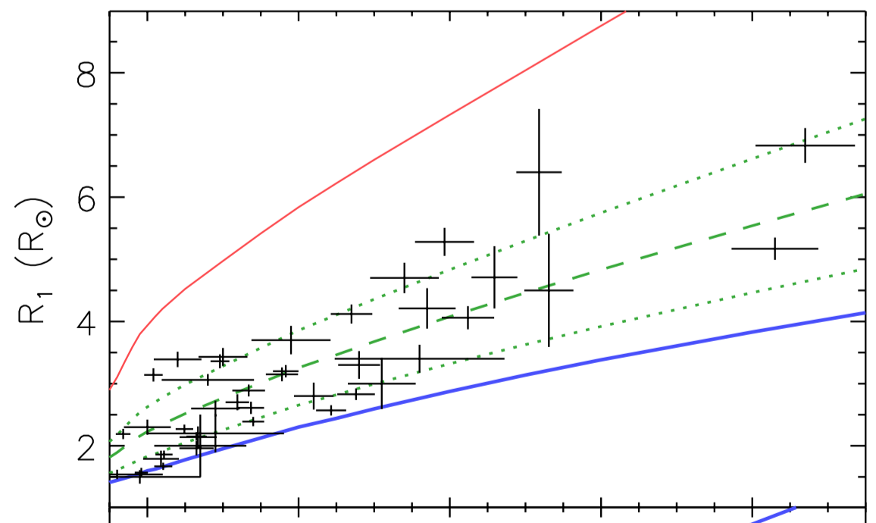
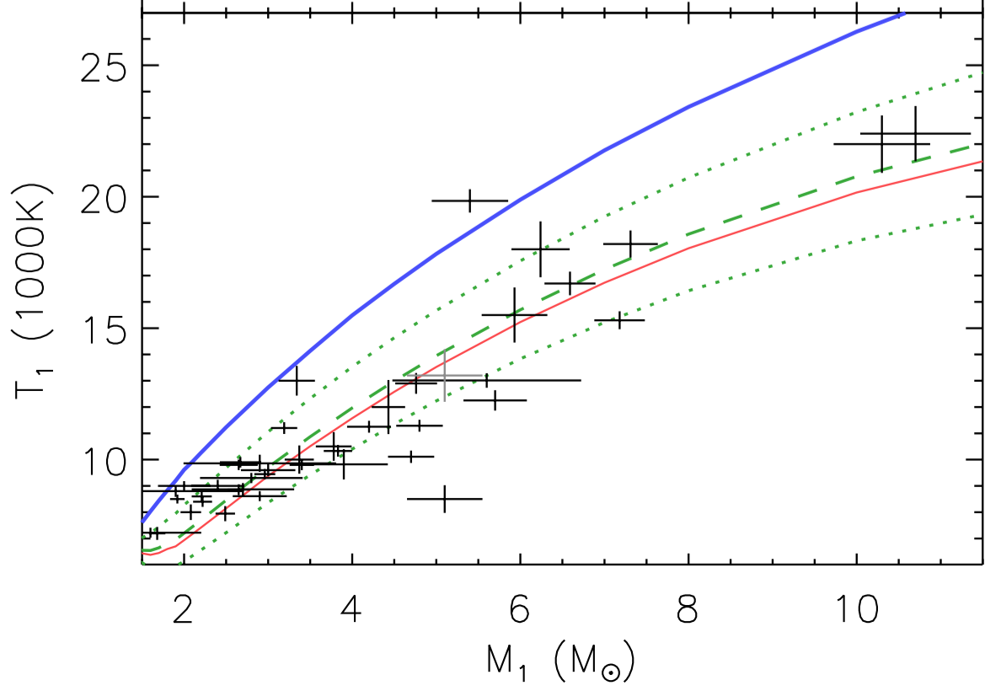
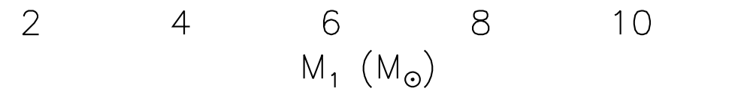
Calibration

Slide 7
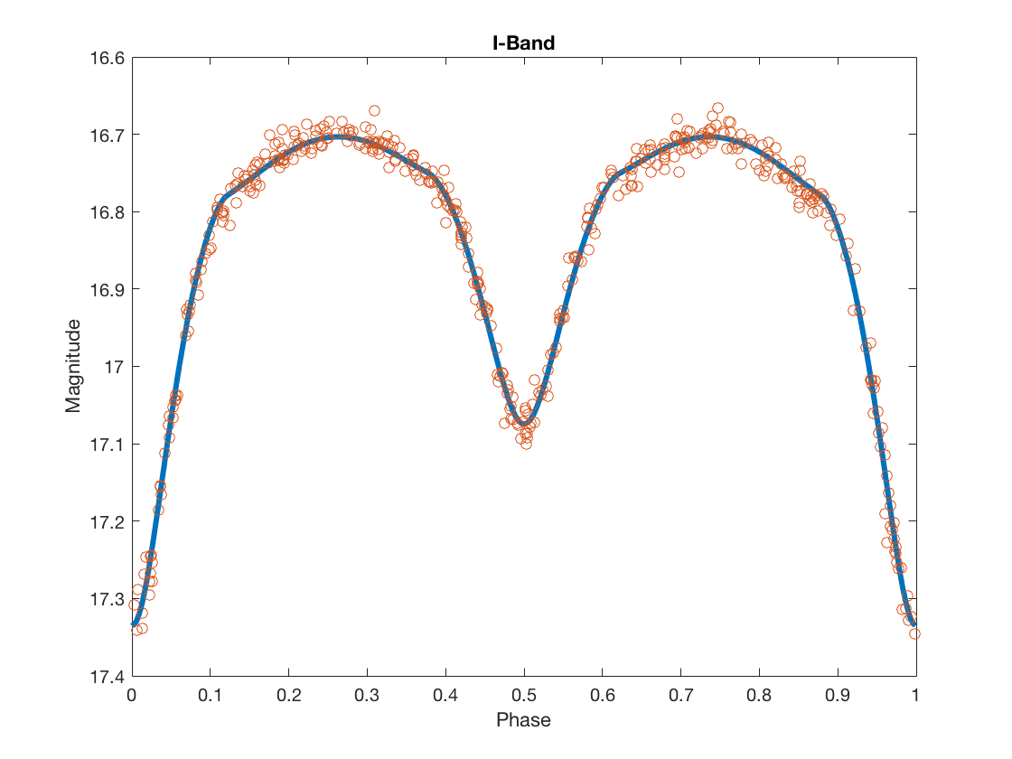
Preliminary Results
ID-00526, Reduced Chi-Squared values 1.0 ± 0.15
Notes:
As you can see, this was after a few thousand steps and it came out to a great fit. This shows us that the most important result is that we can use the photometric data to get the masses of the primary and secondary. Which will be the helpful for future synthesis of Algol type binaries

Slide 8
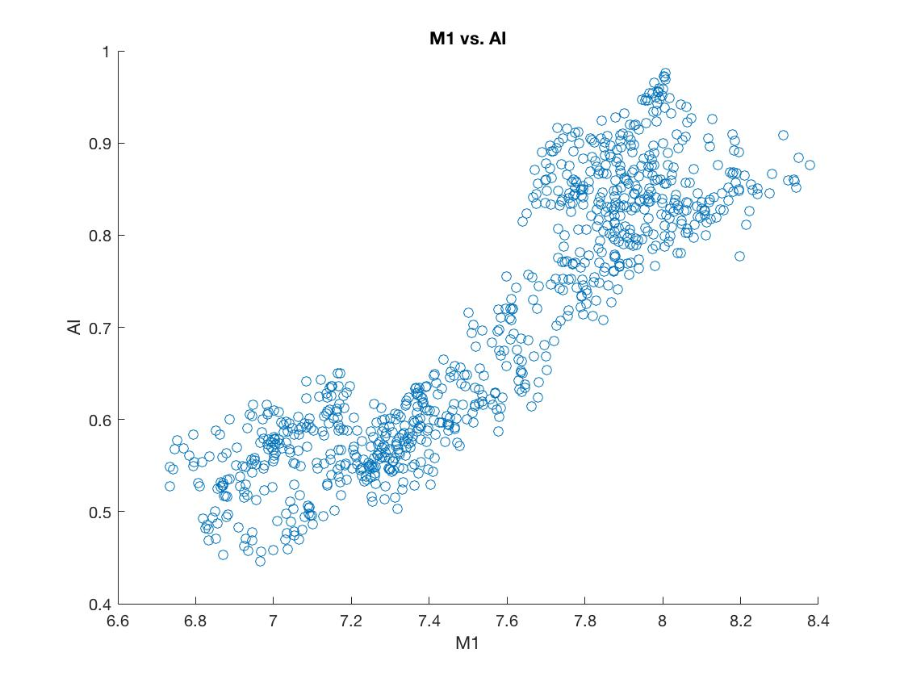
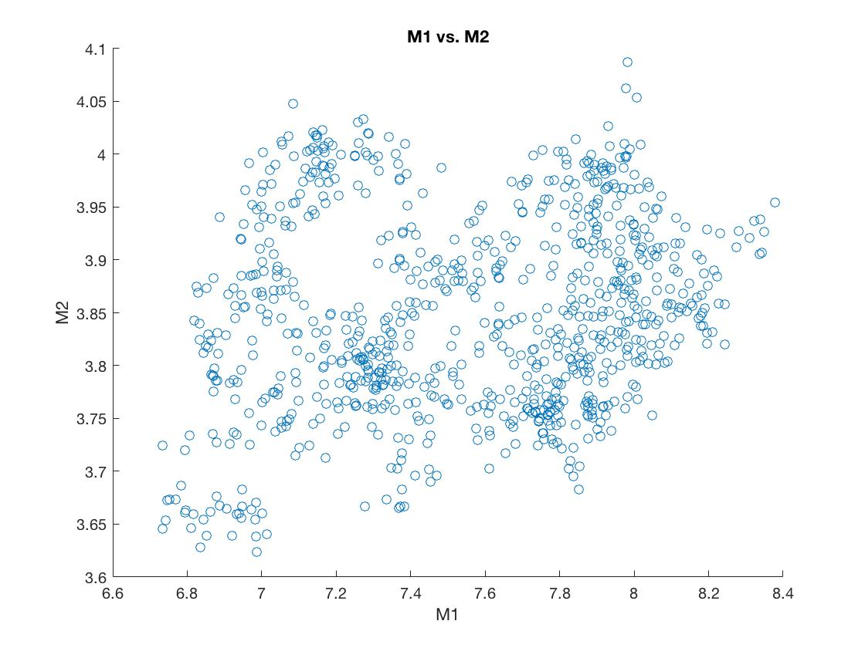
Markov Chain Monte Carlo
Notes:
The MCMC shows that there is a unique solution since all of the points are clustered here and none go out to really far. What’s nice is that M1 has about 15% uncertainty and M2 has about 10% uncertainty. So, if we have a big enough population, this will provide constraints on the physical processes of binary mass transfer.

Slide 9
Future Research
OGLE Variable Star Catalog, 400 Algol-type binaries in the LMC
Period ~1-4 days, mass ~2-10 M☉
Gives us insight on the physical structure of Algols
Sheds light on the process of binary mass transfer and binary evolution
Notes:
The systems we are analyzing have a period of around 1-4 days and mass from 2-10 solar masses. We will continue to find solutions to the rest of the 400 systems. Again, Algols are very complex systems and we don’t know much about them. This research definitely helps give us an idea of their physical structure and will help shed light on the process of binary mass transfer and binary evolution.

Slide 10
Acknowledgements
Special thanks to the NASA Space Grant Program and Dr. Maxwell Moe (mentor).

Slide 11
Thank you

